Slide 1

Deepfake Video Detection
Group Members: Muneeb raza Saood Ur Rahman | Supervisor: Ms. Safia fatima
1

Slide 2
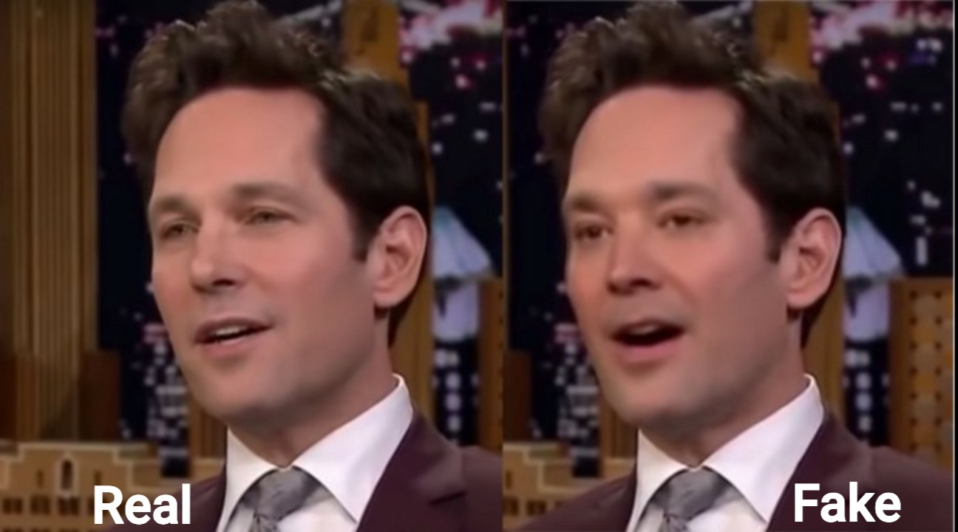
Introduction
What is a Deepfake?
  A video manipulation technique which generates and replaces faces
  Utilizes neural networks
First deepfake video emerged in 2017
Positive Use:
  Updating episodes of movies without reshooting them
where is deepfake today:
  DeepNude Software
  Chinese app Zao
  Etc.
2

Slide 3
WHY WOULD WE WANT TO DETECT DEEPFAKES?
Can be used for malicious purposes:
  Political manipulation
  Evidence tampering
  Fake News
Can be even used to generate fake satellite images of the Earth
3

Slide 4
Scope
Video
Preprocessing
Model
Classifier
Result
4

Slide 5
Literature Review
Deep Learning for Deepfakes Creation and Detection: A Survey
Thanh Thi Nguyen, Cuong M. Nguyen, Dung Tien Nguyen, Duc Thanh Nguyen, Saeid Nahavandi [1]
Exposing Deep Fakes using Inconsistent Head Poses
Xin Yang*, Yuezun Li* and Sewei Lyu [2]
DeepFakes and Beyond: A Survey of Face Manipulation and Fake Detection
Ruben Tolosana, Ruben Vera-Rodriguez, Julian Fierrez, Aythami Morales and Javier Ortega- Garcia [3]
5

Slide 6
Problem Statement
Fake videos created by deepfake techniques have been become a great public issue recently. Its hard for Human eye to distinguish between real and fake videos but using deep learning, this may be achieved with better accuracy
6

Slide 7
Objectives
Collecting Dataset
Dividing video into frames
Detecting human Facial expressions
Training Model
Classification
7

Slide 8
FYP-1:
Weeks | 01 | 02 | 03 | 04 | 05 | 06 | 07 | 08 | 09 | 10 | 11 | 12 | 13 | 14 | 15 | 16
Proposal
Defense
Literature
Collect Dataset
Pre-Processing
Implement Model
Documentation
8

Slide 9
FYP-2:
Weeks | 01 | 02 | 03 | 04 | 05 | 06 | 07 | 08 | 09 | 10 | 11 | 12 | 13 | 14 | 15 | 16
Training & Tuning Model
GUI
Incorporating GUI and model
Testing
Final Defense
Documentation
9

Slide 10
References
[1] Nguyen, T. T., Nguyen, C. M., Nguyen, D. T., Nguyen, D. T., & Nahavandi, S. (2019). Deep learning for deepfakes creation and detection.
[2] Yang, X., Li, Y., & Lyu, S. (2019). Exposing Deep Fakes Using Inconsistent Head Poses. ICASSP 2019 - 2019 IEEE International Conference on Acoustics, Speech and Signal Processing (ICASSP).
[3] Tolosana, R., Vera-Rodriguez, R., Fierrez, J., Morales, A., & Ortega-Garcia, J. (2020). DeepFakes and Beyond: A Survey of Face Manipulation and Fake Detection. Information Fusion.
10

Slide 11
Thank You
11

